Slide 1
INFOGRAPHICS
James Afamefuna Ozoagu

Slide 2




Introduction
Argument
Infographics
Production

Slide 3
INFOGRAPHICS Defined
Information
Graphic Design
An infographic (short for information graphic) is a type of picture that blends data with design, helping individuals and organizations concisely communicate messages to their audience
Virtual
Leaning
More formally, an infographic is defined as a visualization of data or ideas that tries to convey complex information to an audience in a manner that can be quickly consumed and easily understood.

Slide 4



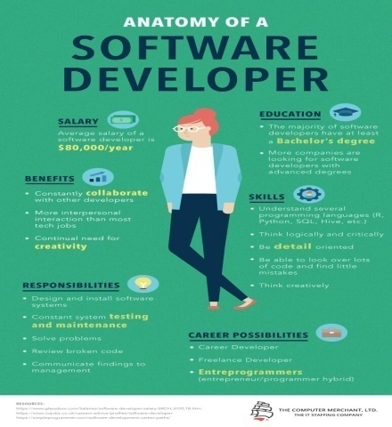
Types of INFOGRAPHIC
HIERARCHICAL - organizes information according to level
VISUAL RESUME - using graphic to represent text based word resumes
MIXED CHARTS - incorporates different chart and graph formats
ANATOMICAL - Using visual metaphors such as the human body to display information

Slide 5
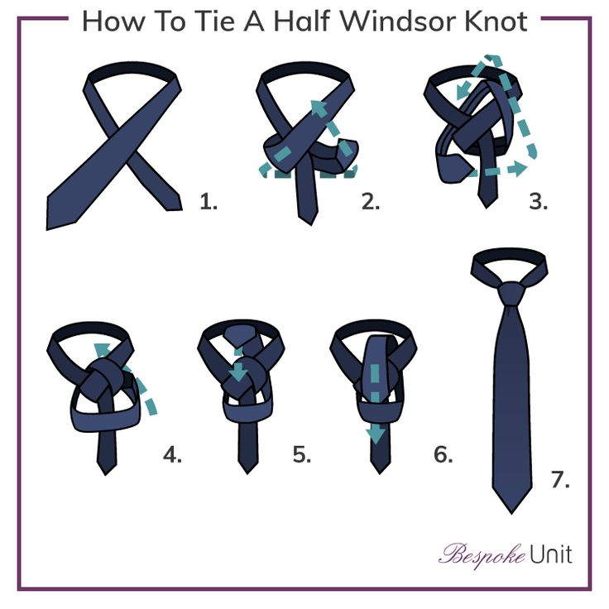
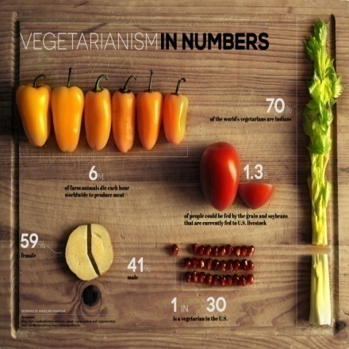
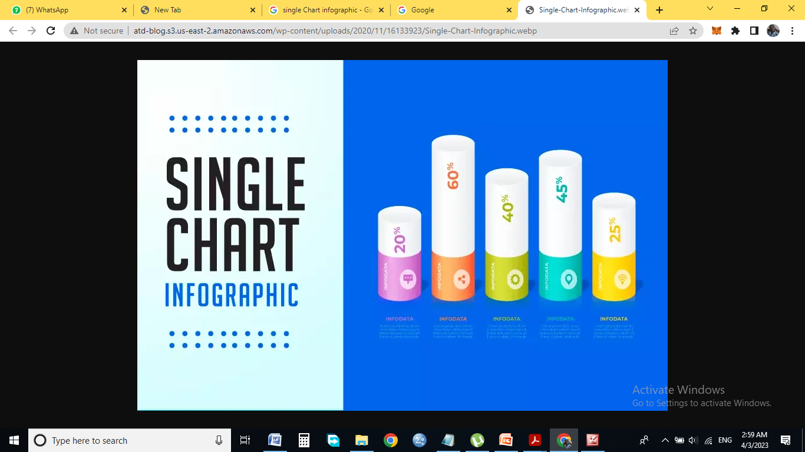

HOW TO -
show steps involved in creating something
PHOTO-GRAPHIC - composed of high quality images
SINGLE CHART - Use of one chart types
Comparison - comparing two products side by side

Slide 6
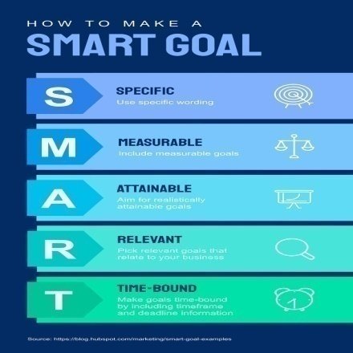


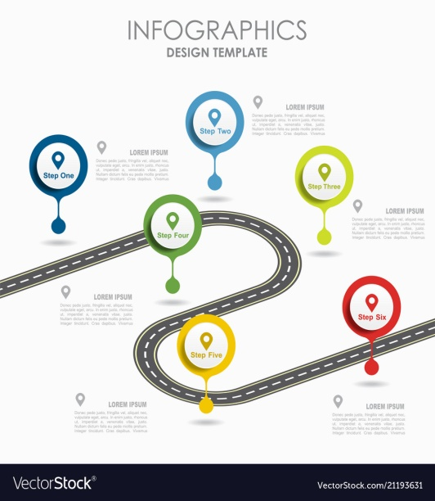

INFORMATIONAL/LIST - composed mostly of text
TIMELINE –
show how something has evolved over time
PROCESS –
flow chart or a decision-tree
LOCATION - comparing regional and global statistics on a relevant subject
VISUALIZED NUMBERS - ideal for adding visual interest in individual units of information

Slide 7



What makes up a good INFOGRAPHIC
Supported by

Slide 8
An Effective Infographic
It tells a STORY
It takes your Eyes on a PREDEFINED JOURNEY
It is WELL STRUCTURED
It send on KEY MESSAGE
It is Visually APPEALLING
It is ACCURATE and WELL-RESEARCHED

Slide 9
Key steps in the process of creating an effective and shareable INFOGRAPHIC is understanding that information can be categorized in one of the five ways
Chronologically
Alphabetically
Geographically
Categorically
Hierarchically

Slide 10


Steps to Creating an INFOGRAPHIC
Define your target AUDIENCE
Define your GOALS
Determine who are you communicating to - help you set the tone of your copy and the overall mood of you visual theme
Ask yourself what you want to achieve with this infographic

Slide 11


Define the MEDIUM
Choose your TOPIC
Determine if you are creating for marketing purpose and publish it online or if you are to translate a report into a print infographic
Ask yourself if you have a topic backed up by data or if you will still conduct research to arrive at a well-supported argument

Slide 12


Find the Right INFORMATION
Process your DATA
Finding the right information starts by consulting right information sources like press releases, recently publish surveys, newly released reports, academic studies etc
Convert the data into a format you can work with

Slide 13

Find the STORY in the data
"Interview" your data to find a story worth telling and detect patterns by visualizing data through different types of charts

Slide 14
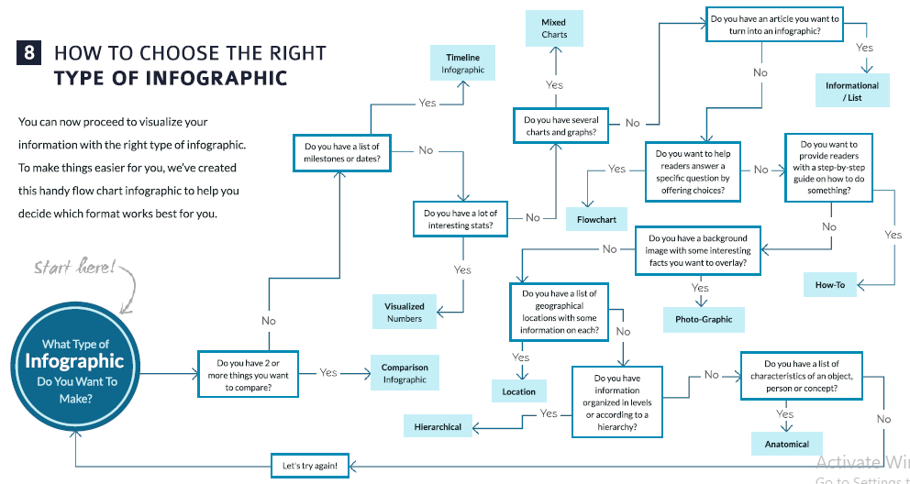
How to Choose the Right Type of
INFOGRAPHIC

Slide 15
How to Create INFOGRAPHIC Copy
The One Huge Idea: The key to developing a successful and shareable infographic, like any other piece of communication, is to focus on the core message you want to convey.
Adding Details to a Story: Consider the story you want to tell before getting into the specifics of how you will display your facts.
Building an Airtight Case: Apart from telling a story, you must also establish a case inside your narrative. This may be accomplished by returning to your major concept and then defining each of your primary points, followed by supporting facts.
Deciding on the Tone: Consider your target audience; if they are millennials, your tone may be laid-back and irreverent; if they are corporate executives, your tone may be more serious and direct.
Create a Textural outline: Here is where you put your thoughts on paper. The textual outline should be short and cohesive with the visual components that will follow your text. In addition, your textual plan should have a title, introduction, body material, and sources.

Slide 16

Establish a Wireframe
This step is where you start turning your text into visual components. Based on the style of infographic you choose, make sketchs of the basic parts (textural and visual) of your final design. What should be in this frame is:
  placement of the introduction, subtitles, and titles
  the position of the indicated states and statistics
  rough drawings of graphs and charts
  rough drawings of icons or illustrations

Slide 17
Design your INFOGRAPHIC
Designing your infographic is all about
  Deciding on a right theme: Use visual elements related to what you are presenting
  Choosing a Color Scheme: Using the right color scheme to suit the information you are passing
  Choosing right font combinations: Fonts determine the mood and overall look and feel of you infographic
  Selecting and Using the Right Icons: The ability to blend the right images with as little text as possible is the key to effective visual communication, and one method to achieve this is to replace words with symbols such as icons.

Slide 18
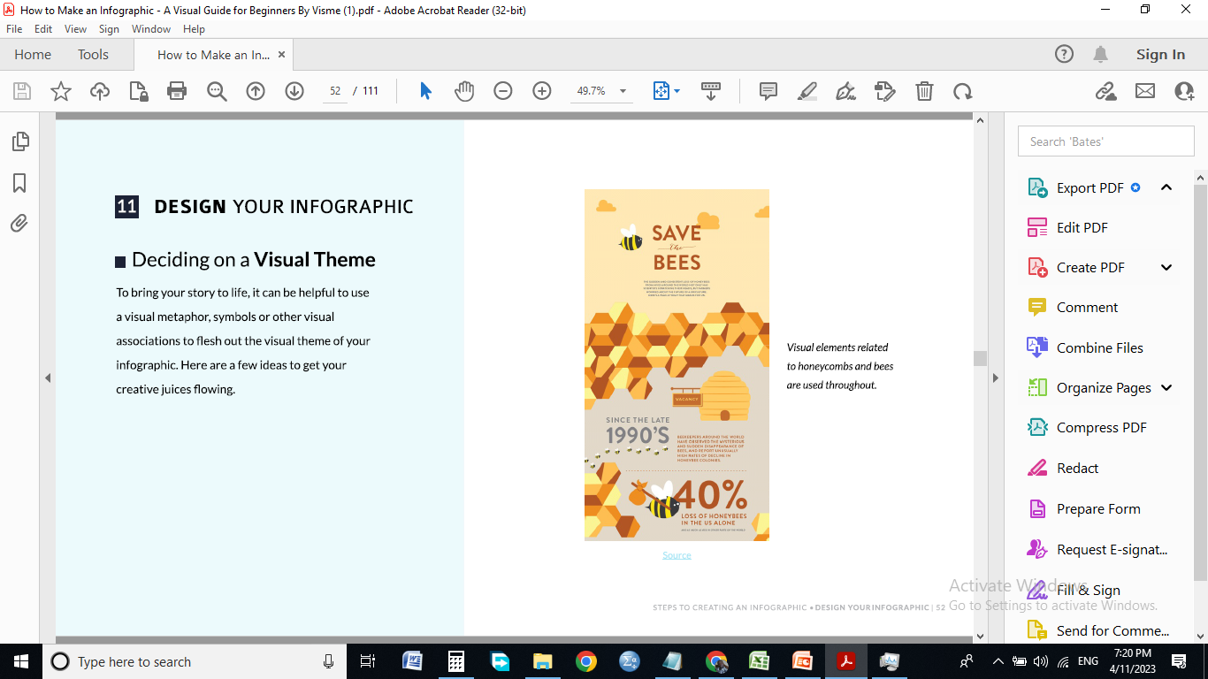
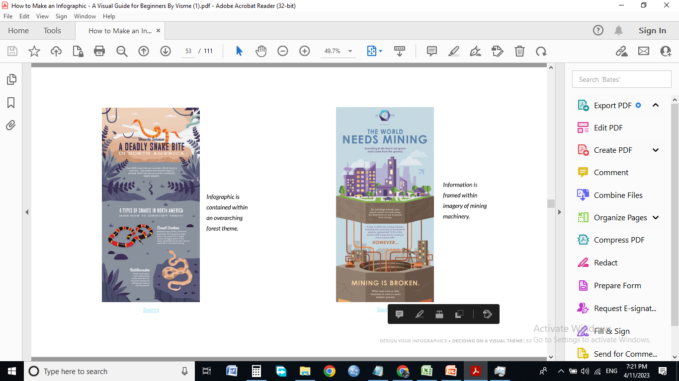
Deciding on a right theme
Use a visual metaphor, symbols, or other visual associations to elaborate on the visual theme of your infographic in order to bring your story to life.

Slide 19
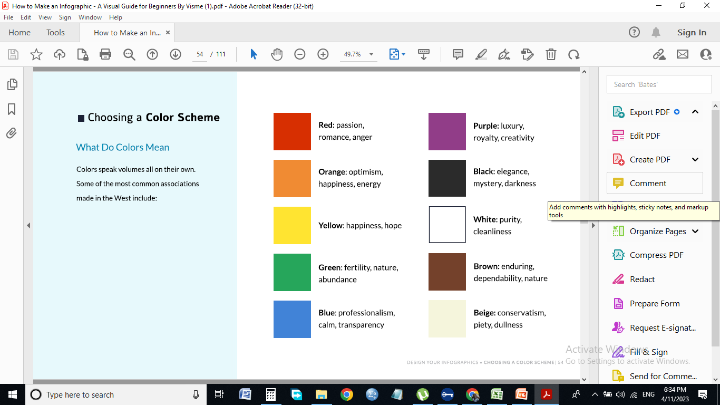
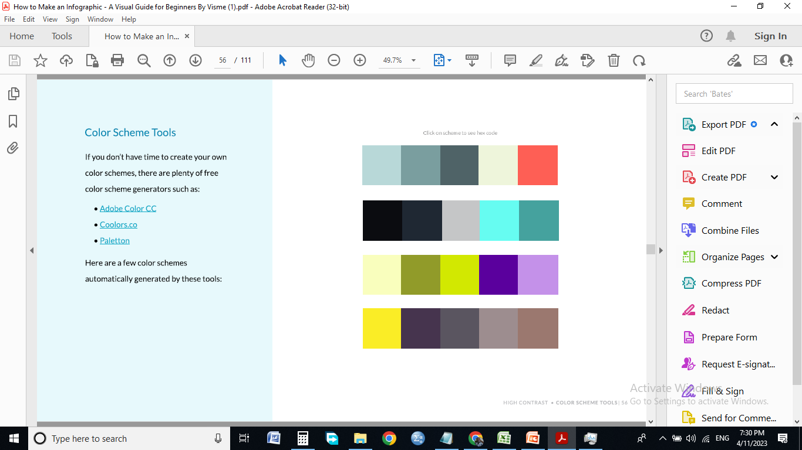
Choosing a Color Scheme
Colors communicate volumes on their own, and knowing the meaning of colors and color combinations will help you pass the proper story.
Always keep is simple
it is important to use 60-30-10 rule i.e. 60% of the primary color, 30% of the secondary and 10% of the accent color

Slide 20









Choosing right font combinations
A Chunky Font Pairs Well With a Skinnier One
Avoid Pairing Fonts That Are Too Different
Pair Two Fonts From the Same Font Family
Try a Traditional Heading with a Decorative Body
Two Fonts With Complementary Moods
Don’t Use Fonts That Are Too Similar
Try Tight Kerning With Looser Kerning
Use a Decorative Heading with a More Traditional Body
Use Serif and Sans Serif Together

Slide 21

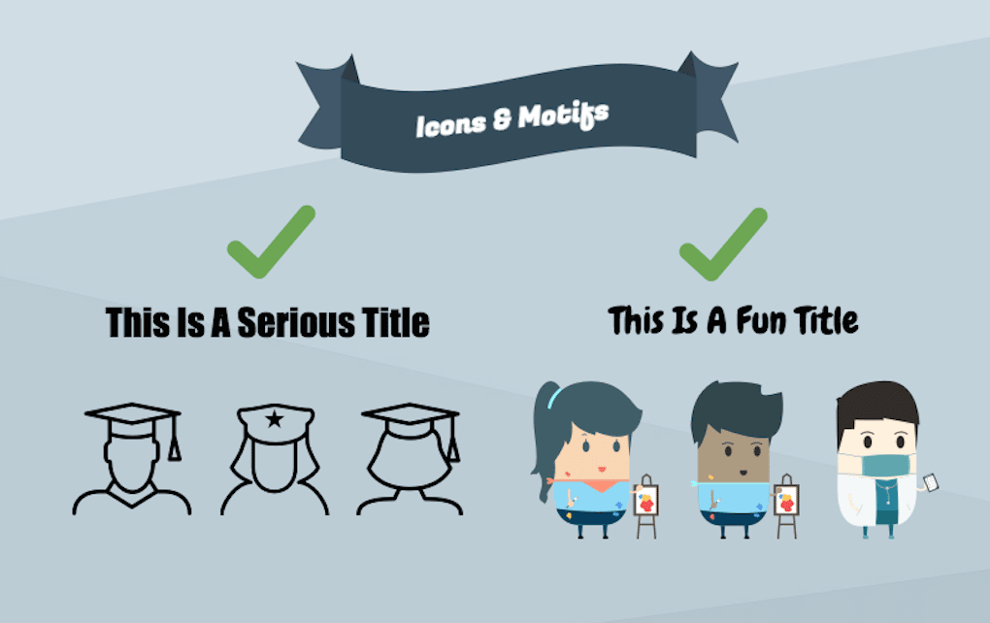
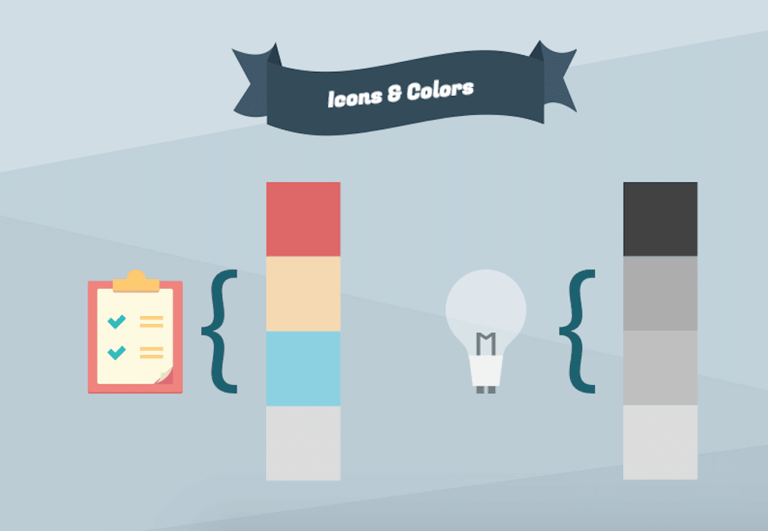
Selecting and Using the Right Icons
Choose an icon style and stick to it
.
Match icons with the right color palette
Pair icons with fonts

Slide 22
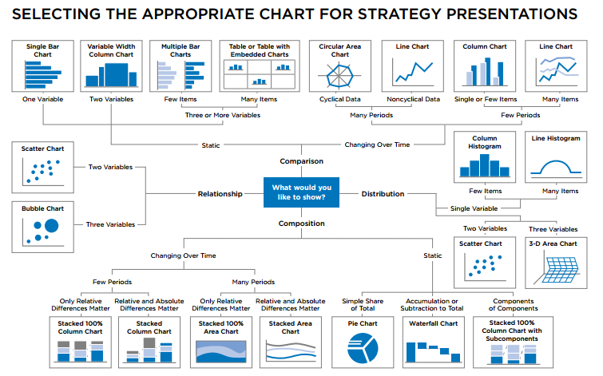
Selecting the appropriate CHART

Slide 23
Infographic Tools for Creating INFOGRAPHICS
Visme
Venngage
Canva
Piktochart
Snappa
Easel.ly
Infogram
Genial.ly
Easil
Befunky
Adobe Spark
Biteable
Others may include but not limited to Adobe Photoshop, Adobe Illustrator, CorelDRAW Graphics, MS office application - PPT, MS word

